Slide 1

Design and development (maintaining) of application software
SPEC: Software development and maintenance engineering

Slide 2
Participants name and ID
Participants | Student ID
Eden Mengesha | 52844
Sofonias Aberra | 52877
Yonas Lemma | 52962
Francis Okechukwu Olekamma | 53032

Slide 3
Escape Coding game
Brief overview about the game :-
Coding Escape is a selection of online escape games created by CodinGame.
For this review, we played The Steam House and Finding Sherlock – The Apartment.
You’ll need to create an account to see these. They aren’t immediately visible on the website.
There are two ways to play the game , As a coder and a non coder( yo will not be required to write any codes to resolve the game.

Slide 4
To pay the game you are required to first do the tutorial hence this presentation will start from the tutorial as well.
We have tried the game with both coder and non coder version, for the tutorial.
The fist task was to open the locked door with a code we can find in the room- the answer to this was “ 1234”. This code was written on the door its self so we wrote this as a return value in the code and executed it . A scene shot of both the image and the code will be provided in the next slide

Slide 5
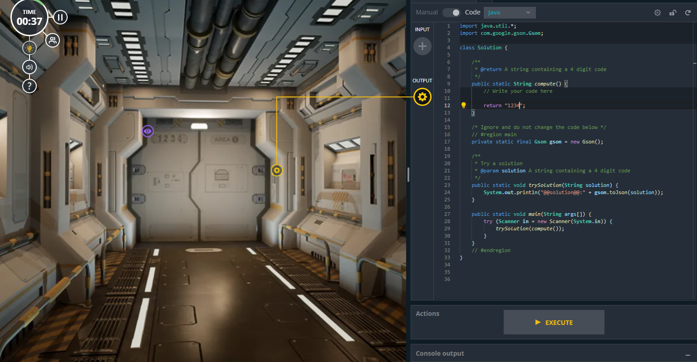

Slide 6
2nd task of the tutorial was to Write the correct combination of numbers I the provided keyboard to open the cabinets . After multiple tries, we noticed that there is also a “+” icon on top of the keyboard so the right answer was to add the numbers shown on the right and left sides of the keyboard. The number on the left side was 1310 and the number on the right side was 2932, so by adding this two values we got the result of 4242 so we wrote that as a return value as well and we were able to complete that task.
Screen shot of the code as well as image as been added on the next slide.

Slide 7
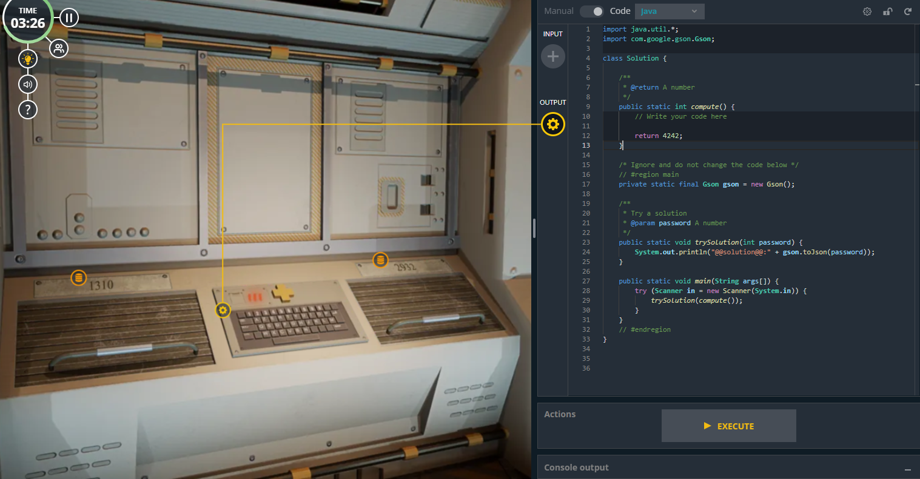

Slide 8
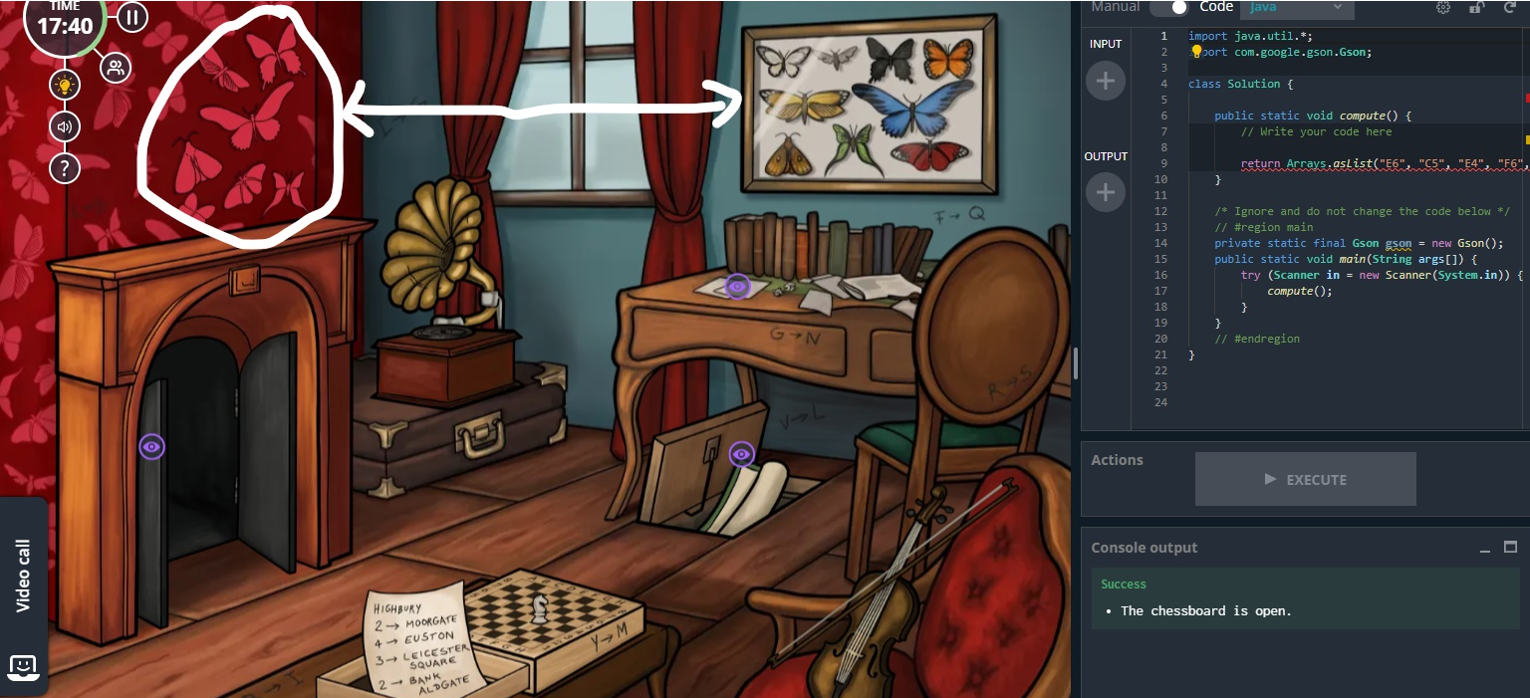
After completing the tutorial, we then proceeded to playing the game The Steam House and Finding Sherlock – The Apartment. We first unlocked the door by clicking on the butterflies that have the same shape as the one on the wall picture → screen shot has been attached below

Slide 9
Then after unlocking the door, we saw a typewriter with the following message on it “DWTK DJK GPYK CN YW SCXRD KGGKYW NCVVCSKO LW DJK GZYLKX DSC JZGOXKO DSKGDW CGK” after a couple of tries and were able to figure out that we had to replace all the letters In this message with its substitute letters that were scattered all around the room. After substituting those letters, we were able to get the following message “TYPE THE NAME OF MY WORST ENEMY FOLLOWED BY THE NUMBER TWO HUNDRED TWENTY ONE “ – Unfortunately non of us has seen or read the book of Sherlock. So, after a quick google search, we figured out the enemy of Sherlock was Professor Moriarty so we used “Moriarty221” as a return value on the code and we were able to pass this task as well and it opened a Map, we had to use to retrace Sherlocks path – screenshot and code has been attached on the next slide

Slide 10
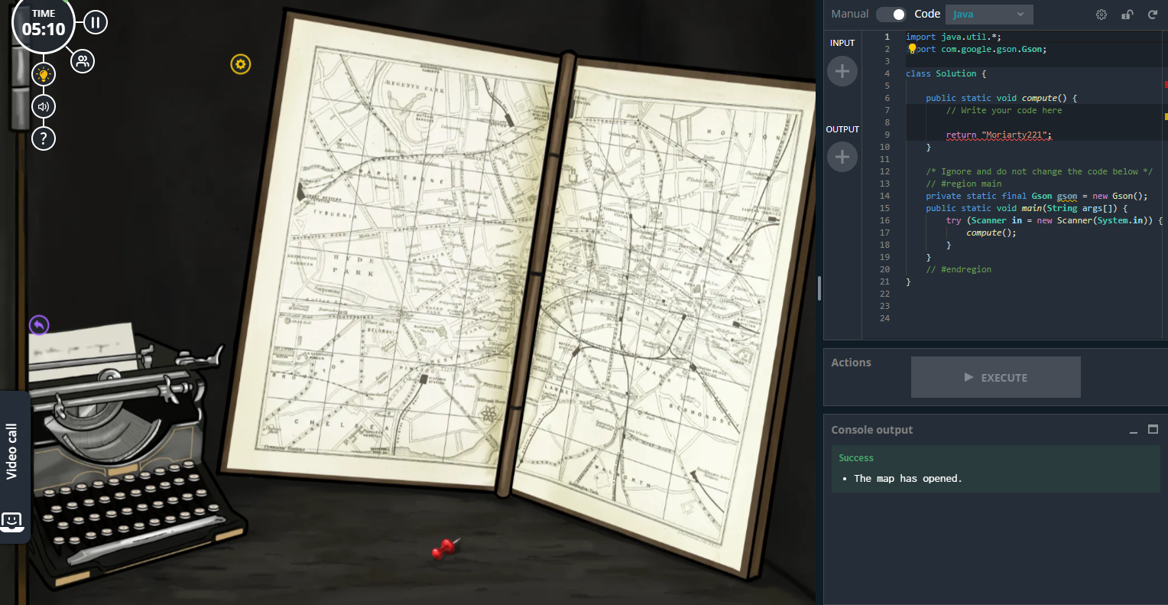

Slide 11
Next, we tackled the task of the violin, this task was fairly easier compared than the others as all we had to do was make the violin have the same sound as the one being played by the record player. As none of has had any prior knowledge to musical notes so we just tried random arrangements of the notes and we were able to solve it.
The Next task we faced was to place the horse on the right place – unfortunately we were not able to get a screen shot of horse's placement on the cheese borde as we were running out of time and we quicky proceeded to trying to solve this task, but a screen shot of the solved result is attached on the next slide
There was a paper with all the steps a horse could make in a case game, after analyzing that we were able to find the answer as the following 'E6', 'C5', 'E4', 'F6', 'G8', 'H6', 'G4', 'F6', 'E8', 'D6', 'B7', 'A5', 'C4', 'D6', 'C4', 'E3', 'G2', 'E3', 'C4', 'A5', 'B7', 'D6', 'C4', 'B2', 'C4', 'E5', 'G6', 'E7', 'C8', 'B6’. After inputing the following as a string value to return we were also able to solve that and that opened the 2 letter right next to it .we have labled the letters ( clues )as 1 and 2 to help us explane the next part . (showen in the screen shot ).

Slide 12
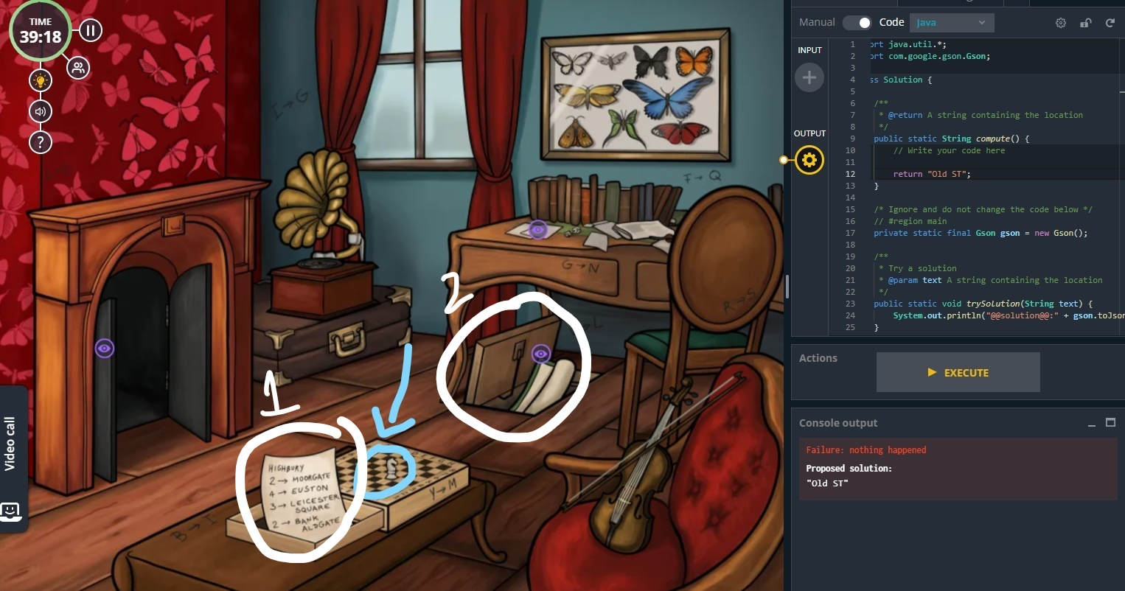

Slide 13
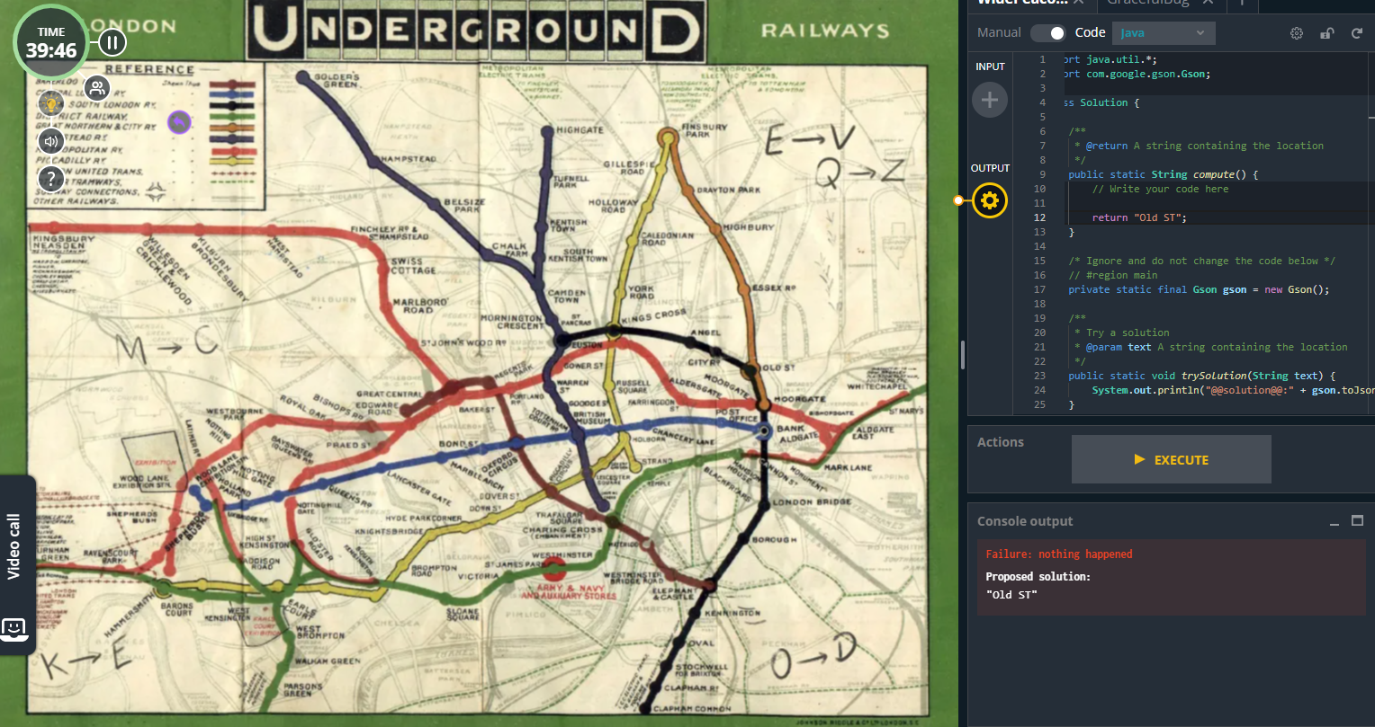
We shown in the previous screen shot we have two clues were , the one next to the cheeseboard is clearly seen however as the 2nd clue isn’t visible until we click on it, we have attached a separate screen shot of that clue below.

Slide 14
So as shown on the screen shot below we are now expected to retrace the path of Sherlock. Clue 1 shows us subway names , as as you can see there are number Infront of them which tells us to start from “Higbury” then 2 towards “Moorgate” and so own following the same logic and we should fine the location , after finding the location we are expected to write it on the return value and execute the code. This is how far we have come with this project.
Thank you for reading this far 🕵️ 🕵️‍♀️

